Slide 1
Flood Rescue Management
MM-Mystic

Slide 2
Agenda
01
02
03
04
05
06
07
Problem Statement
Metrics & Statistics of Flood in India
Proposed Solution – An Overview
Scenario#1 Illustration
Scenario#2 Illustration
Scenario#3 Illustration
Q&A

Slide 3

Problem Statement
India has witnessed some of the worst Flood in last Decade. Two of them are mentioned below:-
2018 Kerala Floods – One of the worst Flood, where more than 36,000 people displaced across the state and 445 people died, In addition to all the 5 gates of the Idukki Dam were opened for the first time in history.
2017 Mumbai Floods - 2017 Mumbai flood was the second worst regional flooding in Mumbai and can be compared with the 2005 Floods. Due to climate change Mumbai received 468 mm of rainfall in twelve hours
Source - http://www.walkthroughindia.com/walkthroughs/15-worst-ever-floods-in-india-over-last-decade/
Key Problems that Surfaces due to Floods Situations are as below:-
No Dedicated Monitoring & Helpdesk Buildings/Infrastructures to monitor the Rescue Efforts.
Due to Network Outage, affected peoples are unable to reach out to Rescue Teams/Helpdesk.
Rescue Team faces challenges to reach out to the highly affected areas on the right time, which slows down the rescue process and risk of damage to life increases.
Rescue Team unable to provide Relief Materials to highly impacted areas due to unavailability of exact geographical Location details and shortest/safest route for quick Mobility.

Slide 4
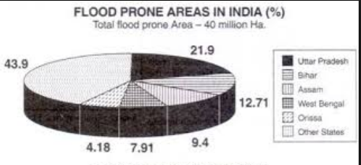
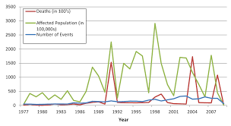
Metrics & Statistics of Flood in India
Source - http://www.yourarticlelibrary.com/flood/essay-on-flood-prone-areas-of-india-2460-words/13931
Source - http://currents.plos.org/disasters/files/2013/01/Floods-figure-3.png

Slide 5
Proposed Solution – An Overview
Build one Building/Infrastructure to act as Rescue Operations Center/Helpdesk in every Flood Prone Areas
The site chosen should be the safest one based on the Geographical and Flooding Historical Data. We are suggesting to use the 2018 solution - PD3R (Post Disaster Rapid Response Retrofit) for this. This will ensure that the building withstand Natural Disaster like Earthquakes, Hurricanes etc.
This Building would act as the Command Center for all the Flood Rescue Operations and will help to integrated with other Rescue Teams such as Armed Forces, NDRF etc.
Peoples should be equipped with Devices which can communicate with the Command Center through Offline Network. (We assume the solution provided by Project Owl for this purpose).
Command Center representatives should be able to communicate with the affected peoples and guide. In parallel, the system should be able to track the exact geographical location of the peoples calling helpdesk. IBM Watson Visual Recognition should access the situation and should be able to trigger helps based on predefined trigger points.
The system should also alert the other Rescue Teams e.g. NDRF etc. with exact details of the Locations, resulting in minimum response time and timely rescue.
Identify the Highly impacted areas using IBM Watson Visual Recognition and trigger the Rescue Efforts using AI/ML for quick Mobility and Basic assistance

Slide 6




Scenario#1 - Illustration
Respond to the calls in relevant language to provide proper solutions and information if required
People from Flood-affected Area
Translate the solution in understandable Language of the Local Rescue Center People
Translate Language which Help-desk people can Understand
Provide solution
Speech-to-Text Conversion
Detect Language
Text-to-Speech Conversion
+
Trained BOT
Help-Desk & Rescue Centre

Slide 7


Scenario#2 - Illustration
RESCUE CENTRE
Send Reliefs based on Severity to the most affected area first
and then to others
Flood affected people
Highly Affected – Mostly flooded and highly populated with lots of children and women
Affected – Rescue Team can reach and provide foods and all
Minor affected –
Will wait to
examine the
condition
Track GPS through
the incoming calls
Find image of that particular place and detect various conditions there through analyzing using Watson Studio Image Descriptor
Help-Desk & Rescue Centre

Slide 8
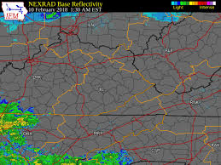
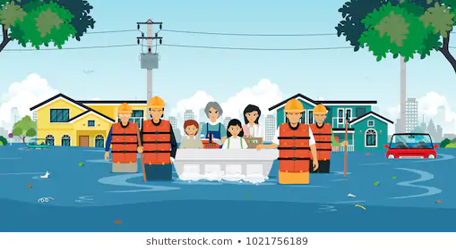

Scenario#3 - Illustration
Using Google Map Rescue team will find the safest path to evacuate the people
People moving to the safest place
Rescue Team
Google Map indicating the routes

